Slide 1

Introduction to ES6
Asheville JavaScript Meetup

Slide 2



About Me
@melindamgolden
Notes:
Been a web developer for over two years
Work for web design company in Atlanta, work remotely in Asheville
Self-taught
Degree in art
Was a wedding photographer with husband
Has a bull terrier named Cypress

Slide 3

What is ES6?
JavaScript is a scripting language that conforms to the ECMAScript specification
ES6 is the sixth edition of ECMAScript that was released in 2015
Also known as ES2015 or ECMAScript 2015
Notes:
ECMAScript is scripting language specification
JavaScript is a scripting language that conforms to the ECMAScript specification
ES6 is the sixth edition of ECMAScript that was released in 2015
Also known as ES2015 or ECMAScript 2015

Slide 4
Why Should I Use ES6?
ES6 features are supported across the latest versions of major browsers (http://kangax.github.io/compat-table/es6/)
Babel converts ES6 into ES5 for older browsers (https://babeljs.io/)
Introduces new features that make your code more concise and readable
Addresses some of the ‘quirks’ of JavaScript

Slide 5
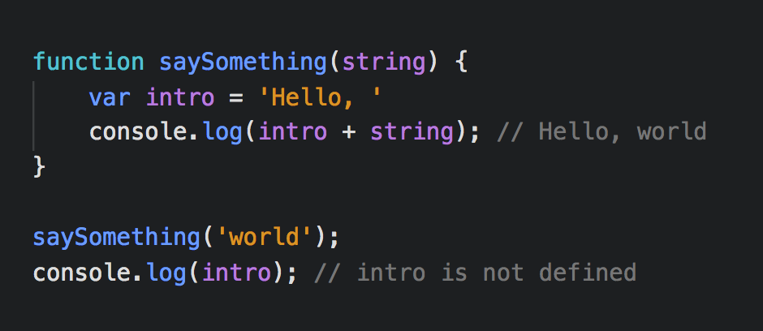
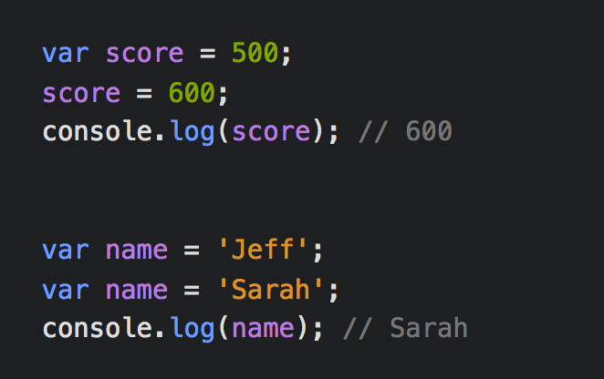
Goodbye Var, Hello Let & Const
Var variables are function scoped
Var variables can be updated or redefined
Notes:
To understand let and const, you must first understand var
Var variables are function scoped
Var variables can be updated or redefined
In the function saySomething(), we have a var variable called intro
If we try console.log() intro outside of the function, it will say intro is not defined
Since var is function scoped, it stays inside the function
In the next example, the var variable called score can be updated
However, in the next example we can declare a var variable with the same name without causing an error
This can cause bugs if you accidentally declare the same variable twice

Slide 6
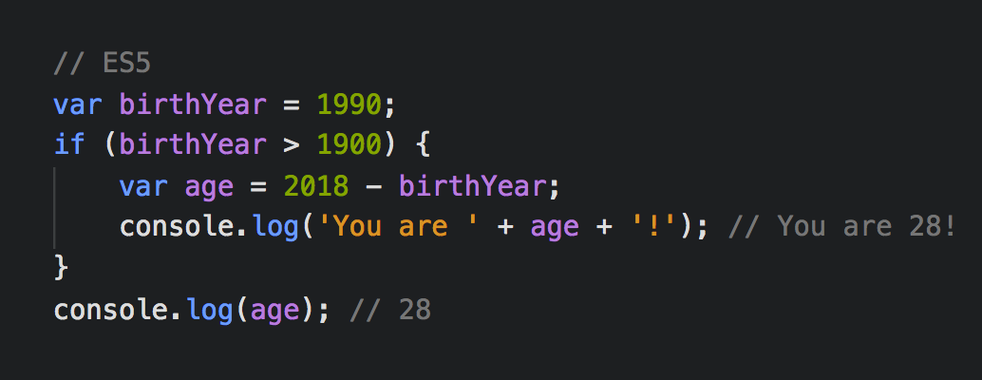
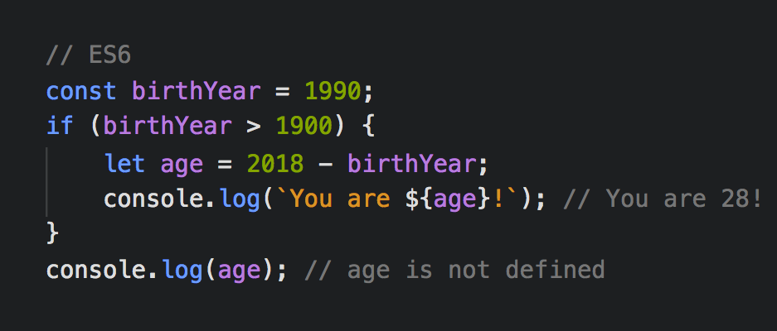
Goodbye Var, Hello Let & Const
Let and const are block scoped
Notes:
Let and const are different from var because they are block scoped
In the ES5 example, we have an if statement with a var variable called age
If we console.log() age outside of that if statement, it will give us 28
Since the if statement is not a function, the age variable leaks out into the global scope
In the ES6 example, we have changed the var variable to a let variable
If we try to console.log() age outside of the if statement, it will say age is not defined
Since let is block scoped, it stays inside the if statement
Blocks are basically anything inside curly brackets

Slide 7
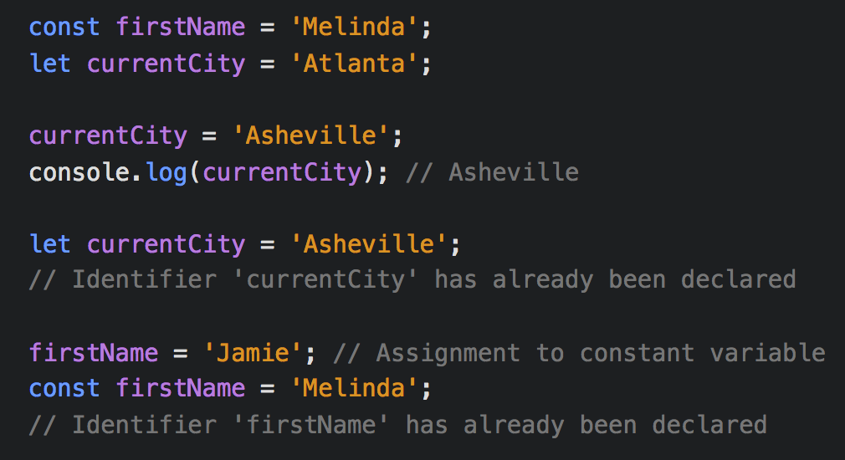
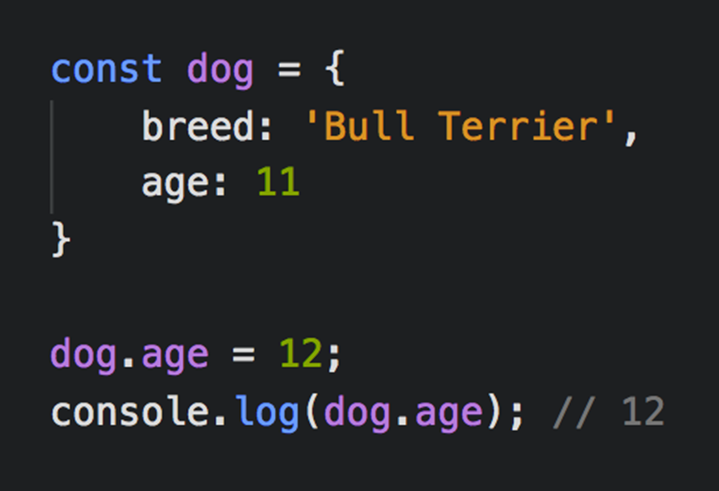
Goodbye Var, Hello Let & Const
Let variables can be updated but not redefined in the same scope
Const variables cannot be updated or redefined
Properties of an object declared with const can change
Notes:
Let variables can be updated but not redefined in the same scope
Const is short for constant
Const variables cannot be updated or redefined
In the example we have a const variable called firstName and a let variable called currentCity
The variable declared with let can be updated
But if you tried to re-declare the let variable, the console would give an error saying it has already been declared
The variable declared with const can NOT be updated
It will give you an error saying assignment to a constant variable
However, properties of an object declared with const can change

Slide 8
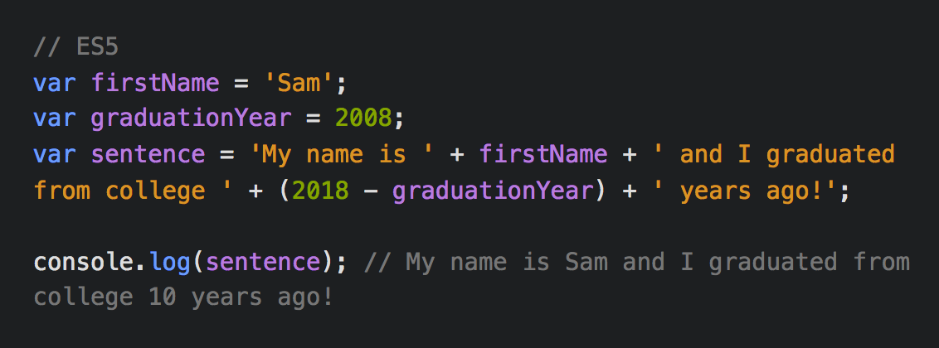
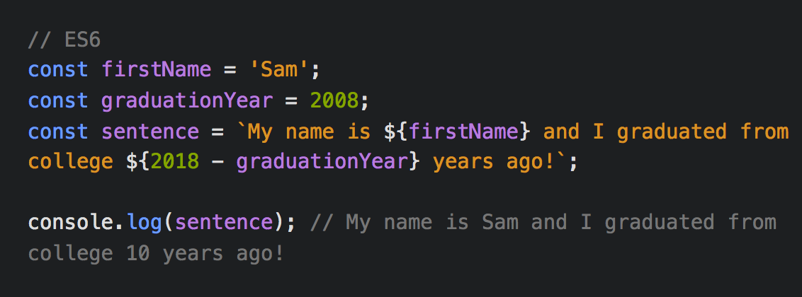
`Template Strings`
Template strings are created by using back ticks
The ${ } syntax is used to interpolate the variables
JavaScript can be used inside the curly brackets
Notes:
Template strings are a new way of creating strings in JavaScript
In the ES5 example, creating a string is complicated and hard to read
Template strings are created by using back ticks
The ${ } syntax is used to interpolate the variables
You can add a variable, run a function, run any JavaScript, or add more template strings inside the curly brackets

Slide 9
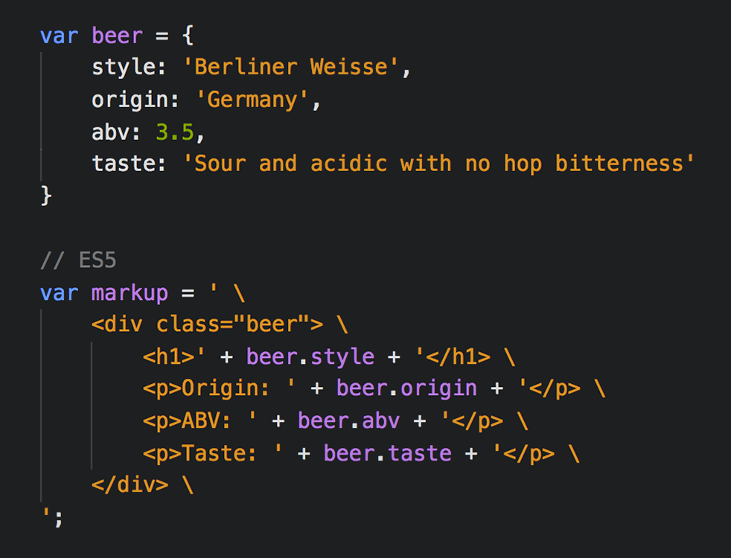
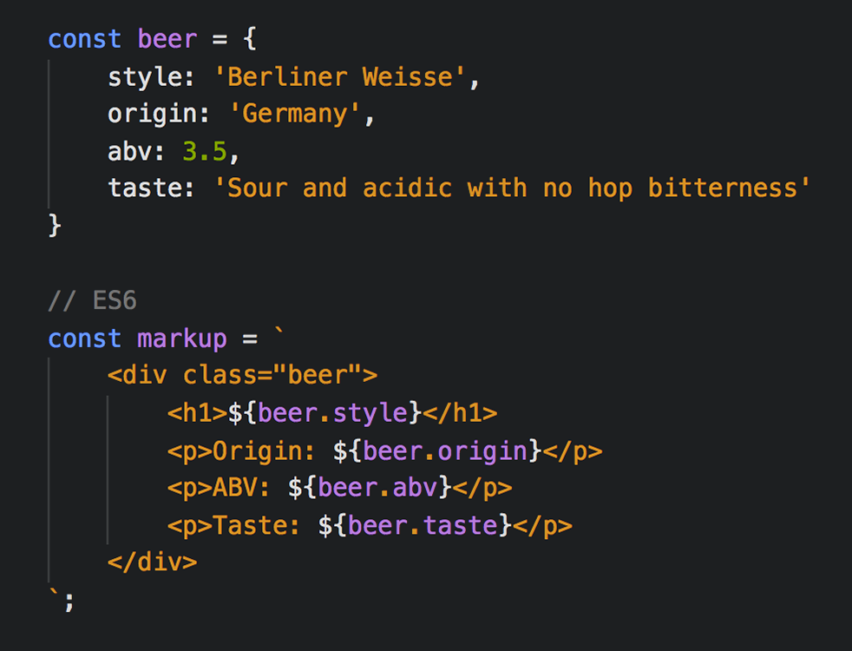
`Template Strings`
Notes:
Another great use for template strings is creating HTML in JavaScript
Previously, to create a multi-line string you would have to escape the new lines
Now you can just use a template string
The spaces ARE included in the string

Slide 10
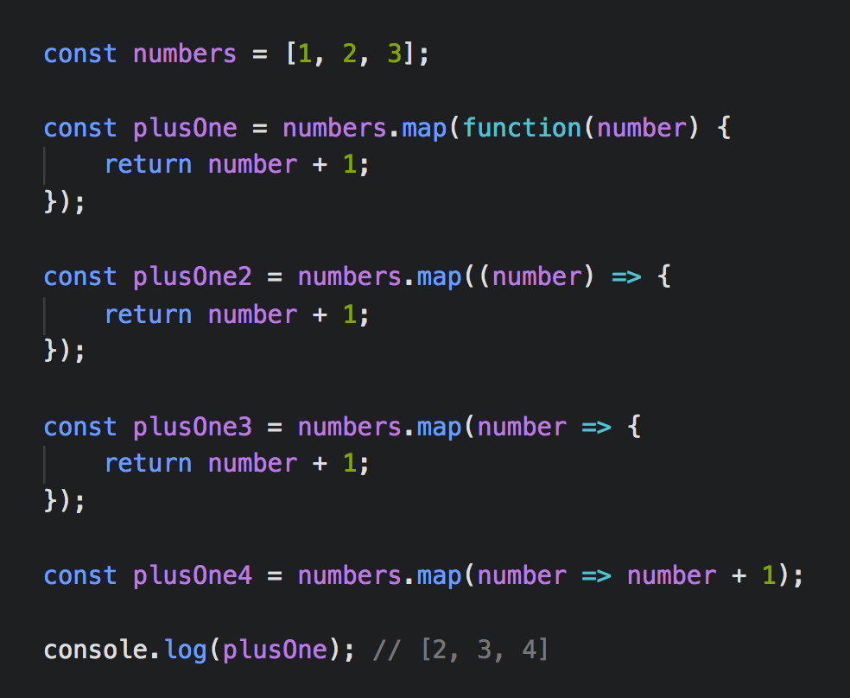
Arrow Functions =>
Arrow functions are always anonymous functions
Delete the function keyword and add a fat arrow =>
No parameter: pass empty parenthesis
One parameter: parenthesis are optional
Multiple parameters: use parenthesis
You can remove the return keyword and { } to create an implicit return on one line
Notes:
Arrow functions have a shorter syntax than function expressions
Arrow functions are always anonymous functions
An anonymous function is a function that is declared without a name
In the example, we have an array of numbers
We are going to perform a map function on that array where we add one to each item in the array
The map method returns an array after doing something to every item in the original array
To change the regular function to an arrow function:
Delete the function keyword and add a fat arrow =>
In this example, there is only one parameter so we can take out the parenthesis
If there is no parameter, you must pass empty parenthesis
If there are multiple parameters, you must use parenthesis
If there is only a return value, you can use an implicit return
You can remove the return keyword and { } to create an implicit return on one line
These function expressions return the same array [2, 3, 4]
Arrow functions are more concise

Slide 11
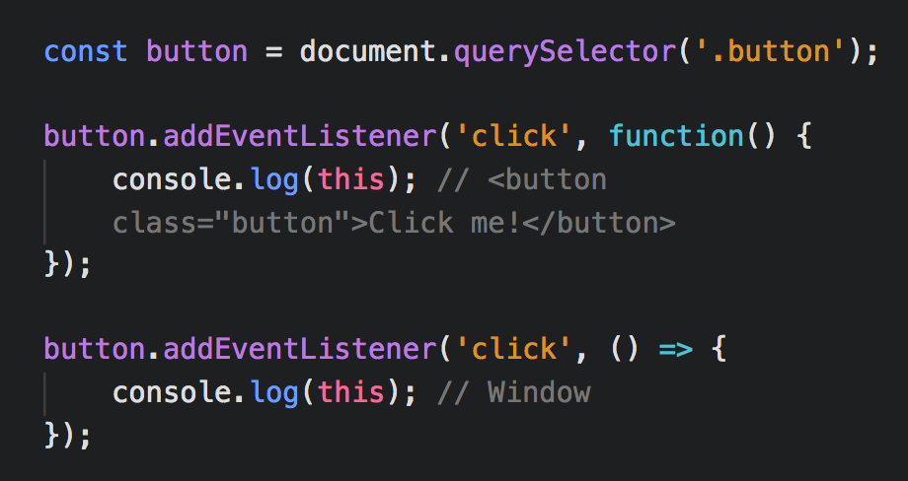
Arrow Functions =>
An arrow function does not change the value of this
Arrow functions inherit the value of this from the parent scope
In the example, the parent scope is the window
Notes:
An arrow function does not change the value of this
This is whatever is to the left of addEventListener
If you console.log() this inside of the addEventListener with the regular function, it will give you the button
With the arrow function, the value of this is the window because it is inherited from the parent scope
Arrow functions inherit the value of this from the parent scope
In the example, the parent scope is the window

Slide 12
When Not to Use Arrow Functions
Click handlers: by using a regular function, the value of this will be the element that was clicked on
Object methods: by using a regular function, the value of this will be the object
Prototype methods: a prototype method allows you to add a method to a class after it has been created. By using a regular function, the value of this will be the class
Arguments object: you don’t have access to the arguments object if you use an arrow function
Notes:
Don’t start using arrow functions everywhere without understanding the pros and cons
Arrow functions do not replace regular functions
When not to use arrow functions:
Click handlers
Object methods
Prototype methods
The arguments object contains an array of the arguments passed to the function

Slide 13
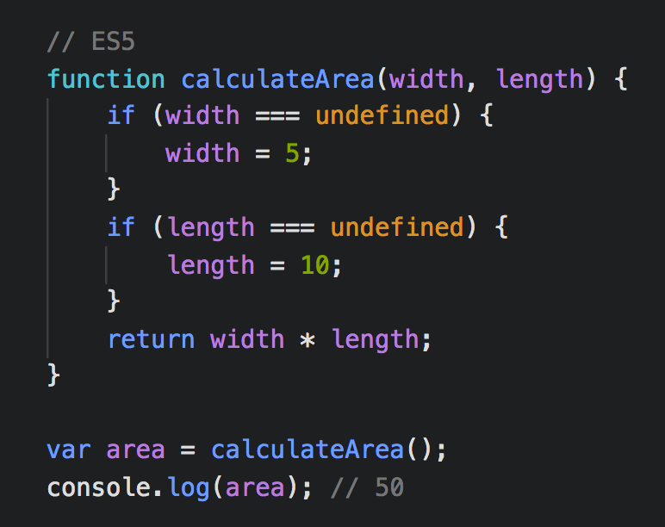
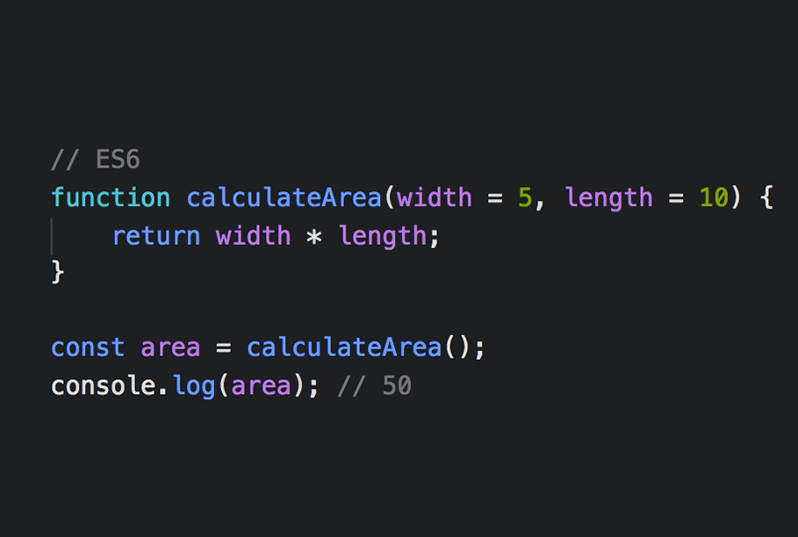
Default Parameters
Default function parameters allow default values to be used if arguments are undefined when a function is called
Notes:
Default function parameters allow default values to be used if arguments are undefined when a function is called
In the ES5 example, we have a function called calculateArea which has two parameters called width and length
If you call the function without passing any arguments, the parameters will be undefined
So you can create an if statement that checks if width is undefined and if it is true then width will be 5
With ES6, we can easily set the default values inside the parameters
Since no arguments are passed to the function, the arguments are undefined and the function will use the default parameters

Slide 14
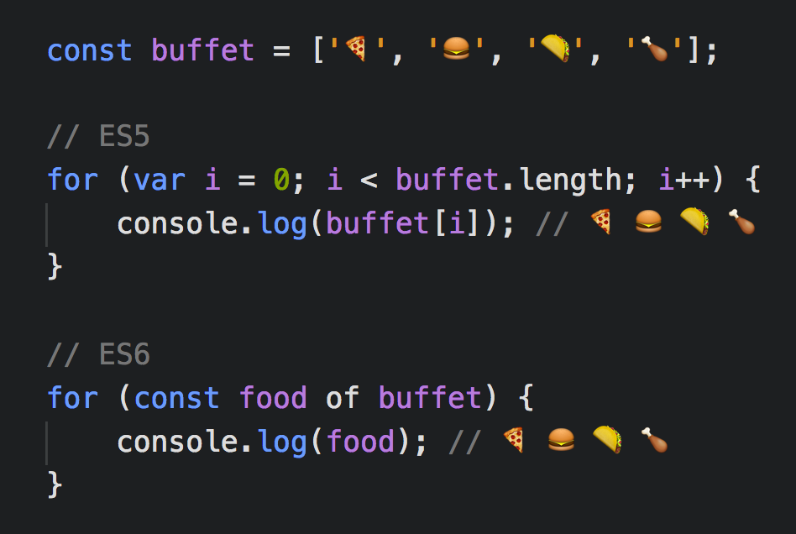
For…of Loop
The for…of statement creates a loop over iterable objects such as arrays, strings, maps, and sets
On each iteration a value of a different property is assigned to the variable
The iterable is the object we are iterating over
Notes:
The for…of statement creates a loop over iterable objects such as arrays, strings, maps, and sets
In our example we have an array of emojis called buffet
If we want to console.log() every item in the array, we would use a for loop
In the ES5 example, the for loop is hard to read and understand
With the for of loop, on each iteration a value of a different property is assigned to the variable
Variable = food
The iterable is the object we are iterating over
Iterable = buffet
Both of these loops do the same thing but the for of loop is easier to understand
Cannot iterate over an object
Able to use break and continue

Slide 15
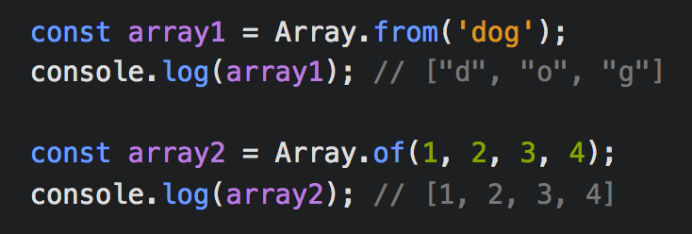
Array Methods
The Array.from() method returns an array from any object with a length property or an iterable object
The Array.of() method creates a new array with any number of arguments
Notes:
There are new array methods in ES6
Array.from() and Array.of() are for the Array object which is a global object that is used in the construction of arrays
The Array.from() method returns an array from any object with a length property or an iterable object
With array1, we are using Array.from() on a string called dog
It will turn all of the letters from that string into an array
The Array.of() method creates a new array with any number of arguments
In the example array2, we use Array.of() and pass in four numbers, it will give us an array with all of those numbers

Slide 16
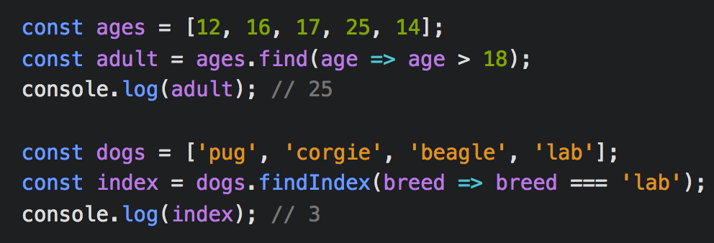
Array Methods
The find() method returns the value of the first element in the array that passes a testing function
The findIndex() method returns the index of the first element in the array that passes a testing function
Notes:
The find() method returns the value of the first element in the array that passes a testing function
In the first example, we have an array of ages
Then we are going to use the find method to look for the first number that is greater than 18
We are using an arrow function
The findIndex() method returns the index of the first element in the array that passes a testing function
In our example, we have an array of dogs
We use the findIndex() method to find the first string that matches ‘lab’ and it will give us the index
Both of these methods execute the function once for each element in the array
If it finds an element where the function returns true, it returns the value or index of that element (and does not check the remaining values)
These methods do not change the original array

Slide 17

Destructuring
Destructuring is a JavaScript expression that makes it possible to extract data from arrays, objects, maps, and sets into distinct variables

Slide 18
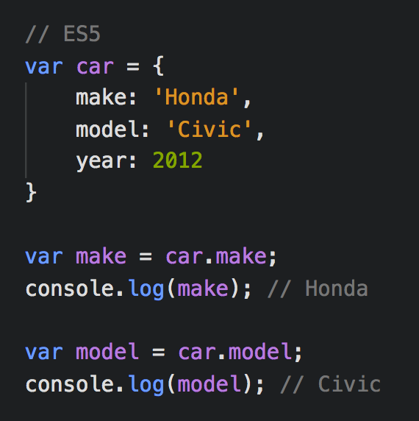
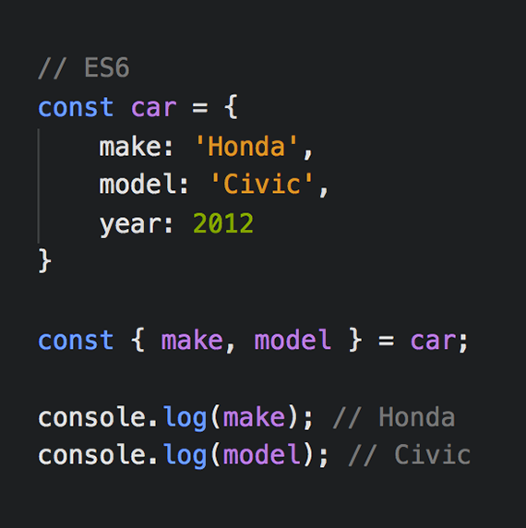
Destructuring
Notes:
We are taking the make and model properties from the car object and turning them into two new variables that are scoped to the parent block
In the ES5 example, we have an object with three properties and we will declare a var variable and assign it to the property in the car object
In the ES6 example, we have the same object but we are using the destructuring syntax to create our variables
We are using the same names as the properties from the object to create the variables and then we are assigning that to the car object

Slide 19
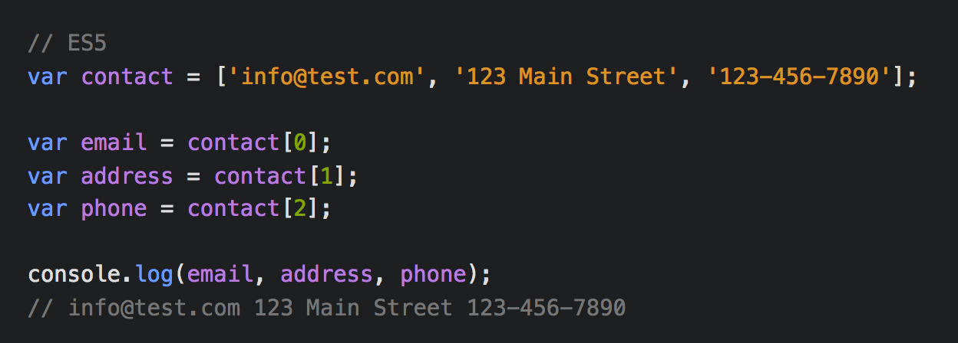
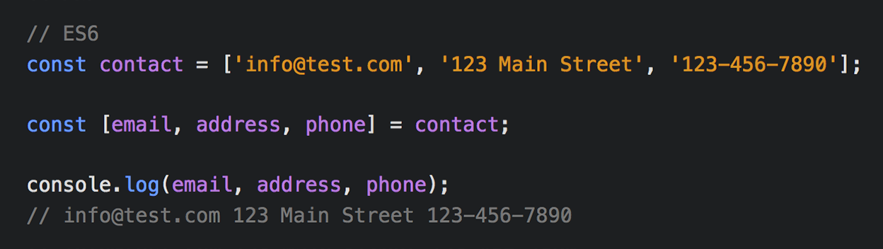
Destructuring
Notes:
For arrays, you just swap out the curly brackets for square brackets

Slide 20
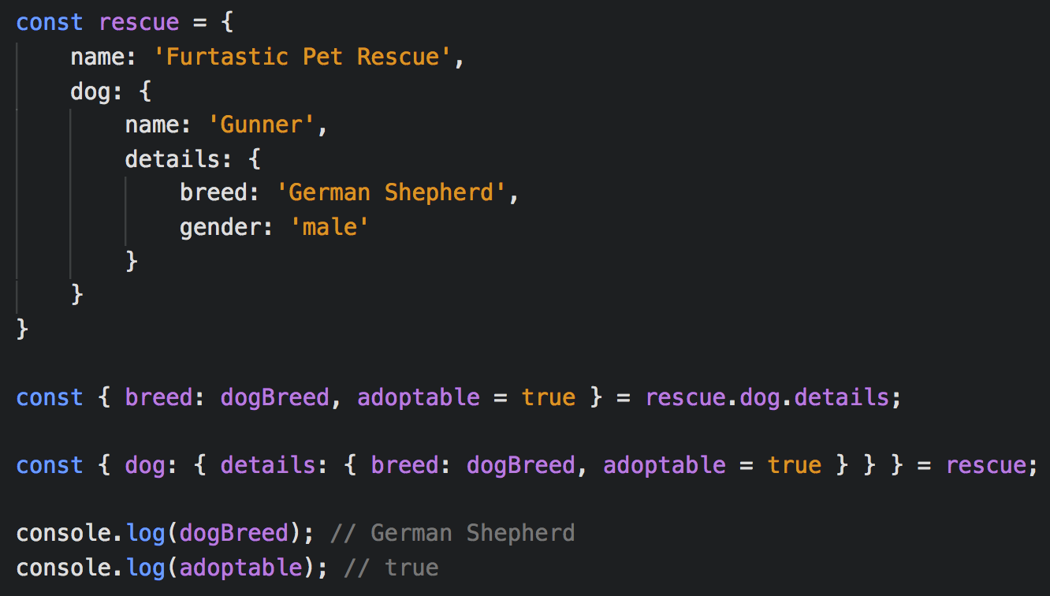
Destructuring
You can access nested data
The object property can be assigned to a variable with a different name
You can provide default values if an object property is not defined
Notes:
Here we have a complex object with nested data
You can access nested data with destructuring
I have shown two examples of how to access nested data
These are the same but I think the first one is easier to understand
You can rename your variables if you don’t want to use the name of the property
We are renaming breed to dogBreed
You can provide default values if an object property is not defined
Since there is no adoptable property, it uses the default value of true

Slide 21
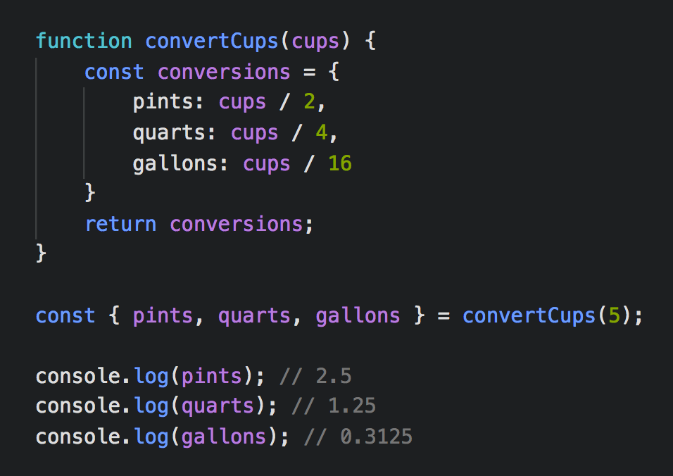
Destructuring
The convertCups function returns an object
The returned object is immediately destructured and new variables are created
The order doesn’t matter and variables can be left out if they are not needed
Notes:
Here is an example of using destructuring with a function
This function takes cups and converts them into pints, quarts, and gallons
The convertCups function returns an object
The returned object is immediately destructured and new variables are created
The order doesn’t matter and variables can be left out if they are not needed

Slide 22
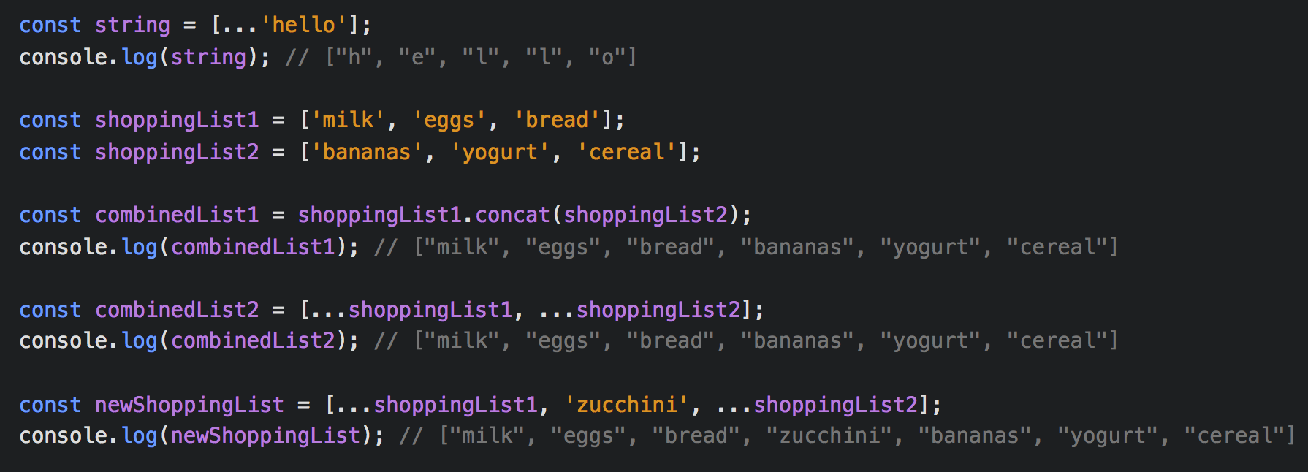
Spread and Rest…
Spread syntax takes an iterable and expands it into its elements
Notes:
Spread syntax takes an iterable and expands it into its elements
The spread syntax is just those three dots
In the first example, spread syntax takes a string and spreads it into individual letters
In the next example, we are going to combine two arrays
We can use the concat() method to combine the arrays
Or we can put the two arrays inside of square brackets while using the spread syntax and they are combined into one array
An advantage to using spread syntax is that other items can easily be added to the new array

Slide 23
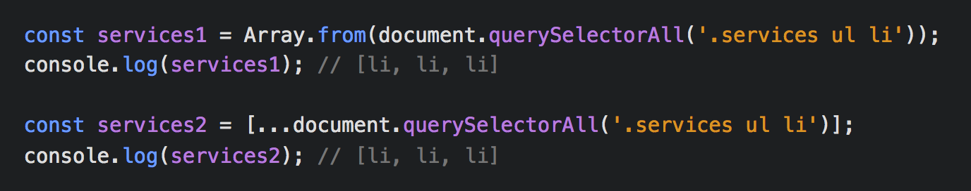
Spread and Rest…
Spread syntax can be used to change a NodeList to an array
Notes:
Spread syntax can be used to change a NodeList to an array
querySelectorAll returns all elements in the document that matches the CSS selectors as a NodeList object
A NodeList is array-like but it doesn’t have the same methods as an array
We can use the Array.from() method to create a new array
Or we can use spread syntax to create a new array

Slide 24
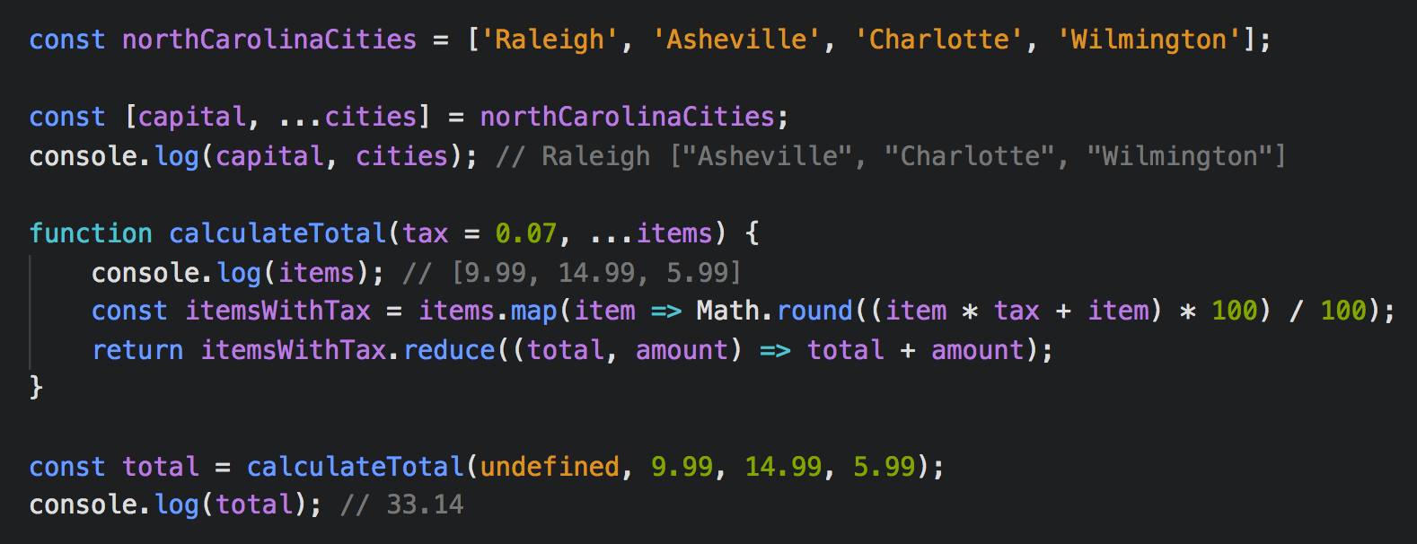
Spread and Rest…
The rest parameter collects multiple elements and condenses them into a single element
Notes:
The rest parameter is the opposite of spread syntax
The rest parameter collects multiple elements and condenses them into a single element
In our first example we have an array called northCarolinaCities
Using destructuring, we created a variable for the capital and the rest are saved into an array called cities
In our next example, we have a function called calculateTotal which will take an unknown number of items and create a total cost
We have created a default parameter for the tax which is 0.07
If we pass undefined to the function, it will use the default value
Since we don’t know how many items there will be, we can use the rest parameter to create an array with all the items
Then we can use map to add the tax to each item
Then we can use reduce to add all of the items together and return the total
The rest parameter is useful when you don’t know how many parameters there will be

Slide 25
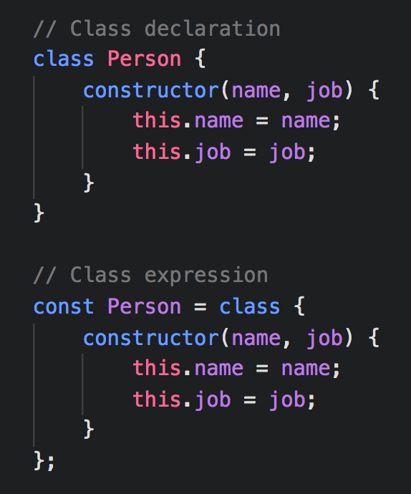
Classes
Classes provide a simpler syntax to create objects and leverage prototype-based inheritance
Classes can be declared with a class expression or a class declaration
The constructor method is a special method for creating and initializing an object created with a class
Notes:
Classes provide a simpler syntax to create objects and leverage prototype-based inheritance
Classes can be declared with a class expression or a class declaration
To declare a class, you use the class keyword with the name of the class
Class expressions can be named or unnamed
In the example, I am showing the two ways of declaring a class
The constructor method is a special method for creating and initializing an object created with a class
There can only be one special method with the name "constructor" in a class

Slide 26
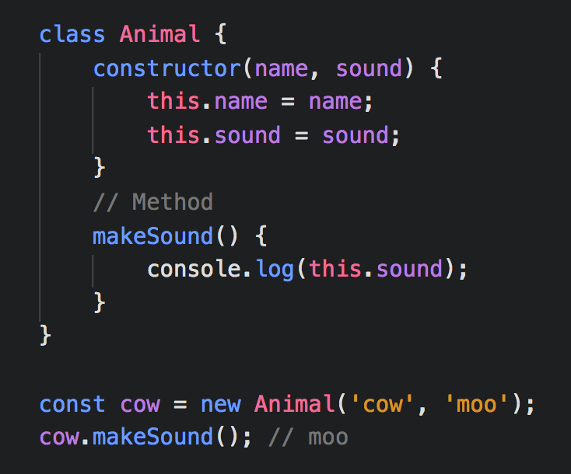
Classes
An instance of a class is created by using the new keyword and then the constructor function is called
Methods are attached to an instance of a class and can be added directly in the class
Notes:
In this example, we are creating a class called Animal which will create two properties called name and sound
An instance of a class is created by using the new keyword and then the constructor function is called
So we are creating a new instance of the class called cow and passing in cow and moo as the arguments
Methods are attached to an instance of a class and can be added directly in the class
In the example, the makeSound() method just console.log()’s the sound
You do not need commas between properties or methods in a class

Slide 27
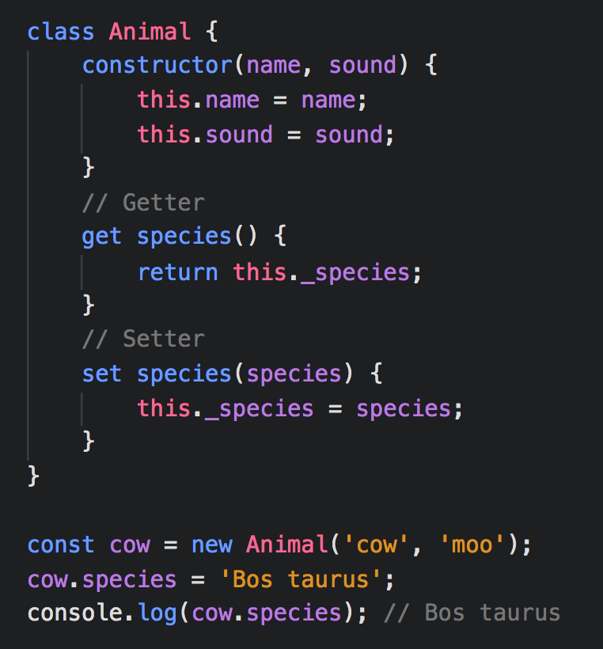
Classes
With getter and setter methods, logic can be included when retrieving or setting the value of a property
A setter method receives a value and can perform logic on that value, then it either updates an existing property or stores it to a new property
When a getter method is called, a property value is computed and returned, but this value is not updated or stored anywhere
Notes:
With getter and setter methods, logic can be included when retrieving or setting the value of a property
A setter method receives a value and can perform logic on that value, then it either updates an existing property or stores it to a new property
To use the setter method, just type the name of the object followed by a dot and the name of the setter method and assign it to a value
Setters always receive one parameter which is the value of the property to be set
In the example, we are using the species() setter method and passing in the string ‘Bos Taurus’
The name of the property cannot be the same as a getter or setter method, so we have to create a ‘backing property’ which is the name of the setter function but with an underscore
If you try to console.log(cow.species) before creating the getter method, you would get undefined
The getter method returns the value of the backing property
When a getter method is called, a property value is computed and returned, but this value is not updated or stored anywhere
The value of the property computed in the getter method can be accessed like a regular property using dot or bracket notation
In the example, we can console.log() cow.species and it will give us ‘Bos Taurus’

Slide 28
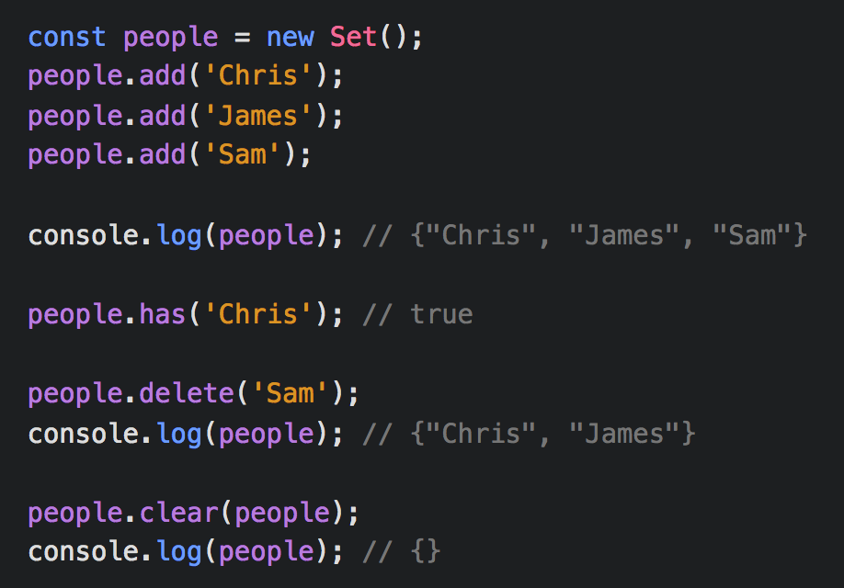
Sets
The Set object lets you store unique values of any type
The add method adds items to the set
The has method checks if the set contains a certain element
The delete method removes an element from a set
The clear method removes all items from the set
Notes:
ES6 has introduced new data structures
The Set object lets you store unique values of any type
A value in the Set may only occur once
It’s different from an array because you can’t access the items individually and it’s not index-based
You can think of a set as a list of items we can add to, remove from, or loop over
The add method adds items to the set
The has method checks if the set contains a certain element
The delete method removes an element from a set
The clear method removes all items from the set

Slide 29
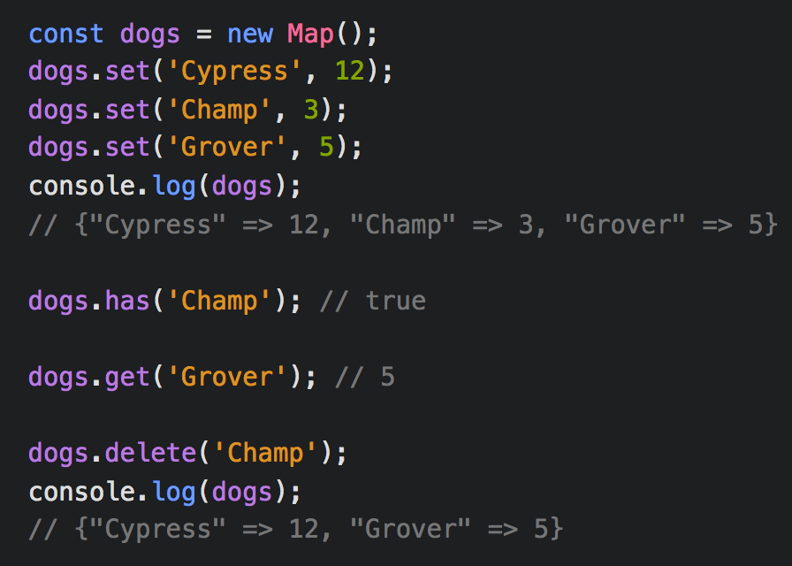
Maps
The Map object holds key-value pairs
The set method adds or updates an element with a specified key and value to the map
The has method checks if the map contains a key
The get method returns an element from a map
The delete method removes a key-value pair from the map
Notes:
The Map object holds key-value pairs
A map is similar to a set except it has a key and a value instead of just values
The keys and the values can be anything
One benefit to using a map over an object is that you can use a for of loop
The set method adds or updates an element with a specified key and value to the map
The has method checks if the map contains a key
The get method returns an element from a map
The delete method removes a key-value pair from the map

Slide 30

Resources
ES6 for Everyone es6.io
Learn ES2015 babeljs.io
Introduction to ES6 learn.co
ES6 in Depth ponyfoo.com
freeCodeCamp freecodecamp.org

